Slide 1
(1) EPrints Services

Slide 2
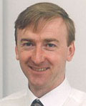
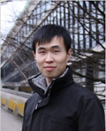
EPrints Services
Tame Academic
Les Carr
Strategy &
Management
Justin Bradley
Kelly Terrell
Adam Field
Sheridan Brown
John Darlington
Jiadi Yao
Will Fyson
Dave Newman
Huw Fryer
Sales &
Marketing
Repository Developers

Slide 3
EPrints Services
Not for profit
Exists to serve the OA community
Charged for services (hosting, support, etc)
Lead on EPrints roadmap and releases
Provide a funding stream for EPrints development
Does not OWN EPrints

Slide 4
(2) EPrints Software
Our Vision

Slide 5
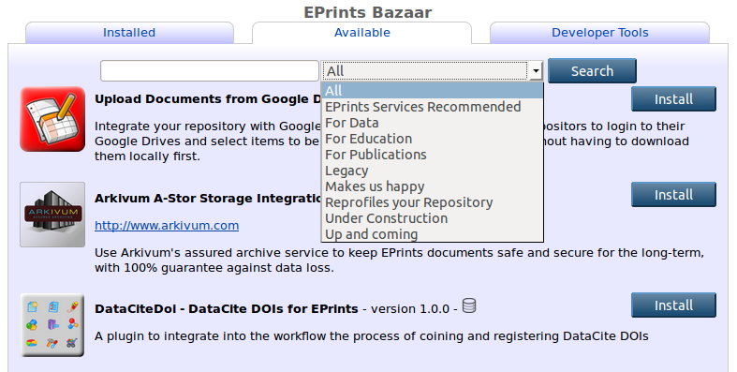
EPrints 3.3.14

Slide 6
EPrints 4 / 3.4.0 Key Philosophy
“Base” EPrints storing and handling of generic data and objects
“Layers” to handle specific metadata schema, import/export, rendering, search, etc. for specific domains

Slide 7
3.4 Releases
Collections of metadata schemas, renderers, plugins and packages tested together for a specific purpose (the pizza model)
Initial Releases for:
Open Access Publications
Open Education
Open Data

Slide 8
EPrints 3.4 for Publications
Publications
Metadata Schema
IRUS Tracker
Publications Router
ORCID Support
WOK / Scopus
Projects / Funder & Rioxx2
IRStats 2
Base

Slide 9
EPrints 3.4 for Open Education
Education
Metadata Schema
MePrints
Bookmarks
Collections
EdShare Style User Interface
Base

Slide 10
EPrints 3.4 for Open Research Data
Research Data
Metadata Schema
ReCollect
DataCite
Arkivum
Exemplar Simple
Storage Plugin
Large File Upload Mechanisms
Base

Slide 11
EPrints for Dataset Showcases
Bespoke Dataset
Importer
Renderer
Base

Slide 12
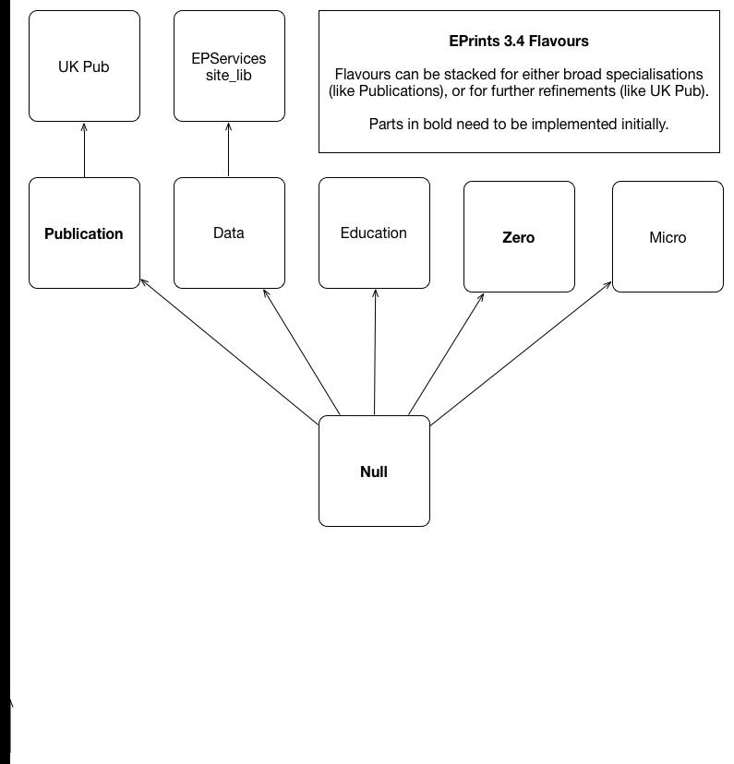
US Pub

Slide 13
(3) Community

Slide 14
Community Engagement
New Role in EPrints Services
To understand and promote community agendas
To support community members
To facilitate community contributions
Recent Activities
Supported development (presented later)
Training videos
Wiki Improvements
EP-tech interaction
Nagging for documentation

Slide 15
What do you want?
EPrints Software Roadmap
New Features
Strategic Direction
Community Support
What can I do for you?
EPrints Services
What can we do for you?

